Slide 1



Totally geodesic submanifolds of the homogeneous nearly Kähler six-manifolds
Juan Manuel Lorenzo Naveiro
CITMAGA – Universidade de Santiago de Compostela
Geometry day, 11 April 2024
Joint work with Alberto Rodríguez-Vázquez

Slide 2
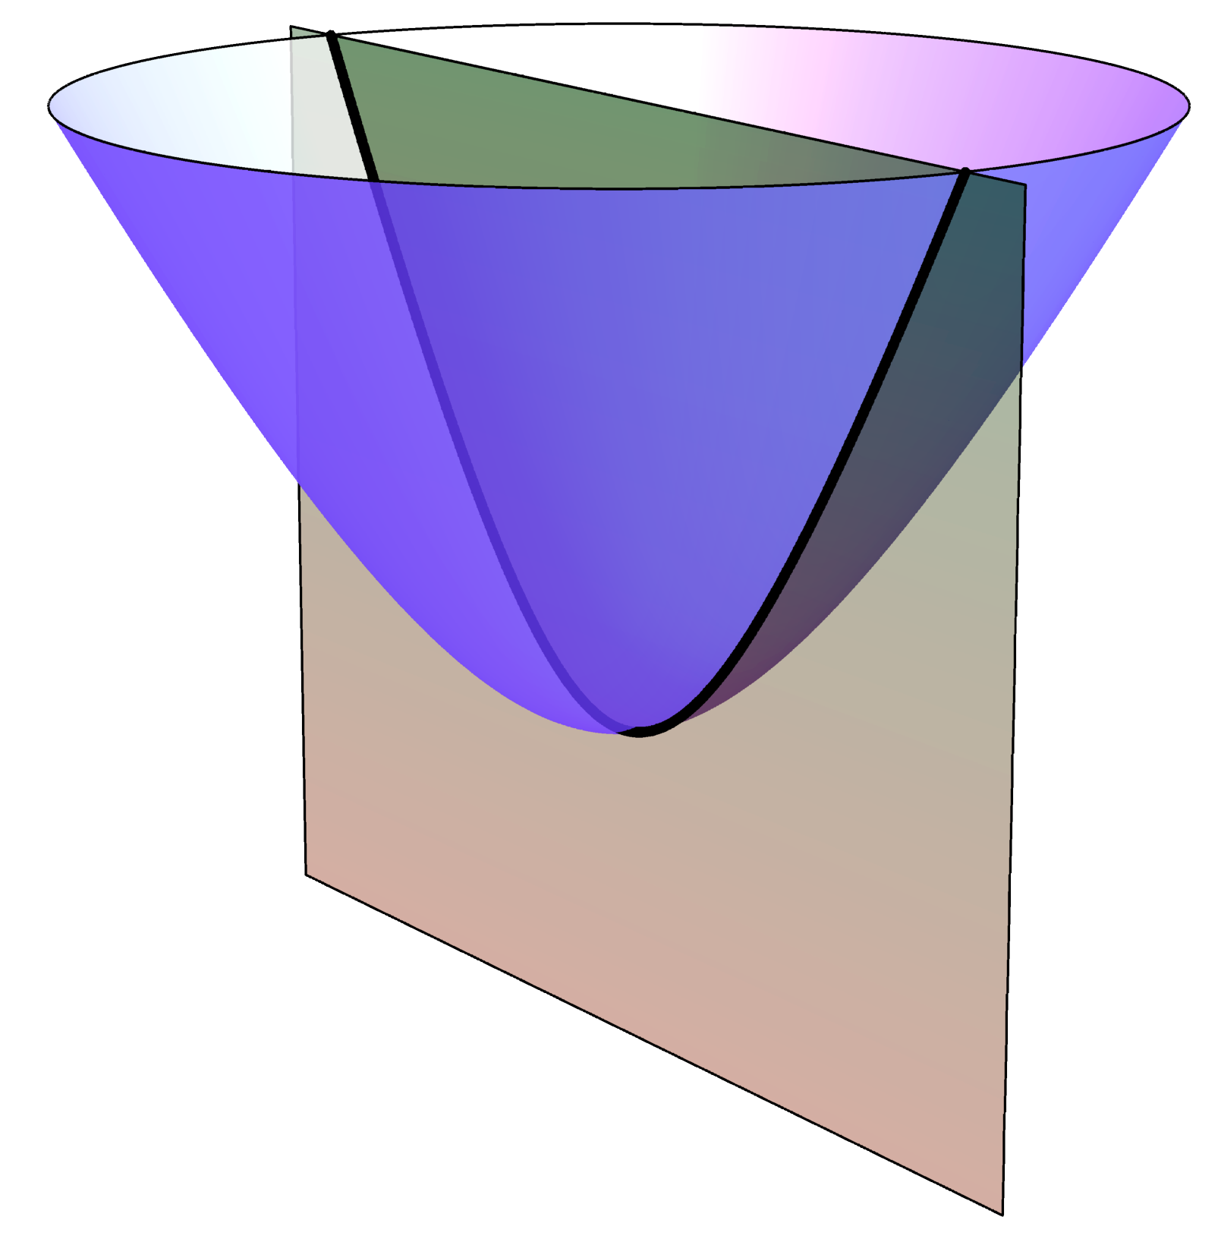
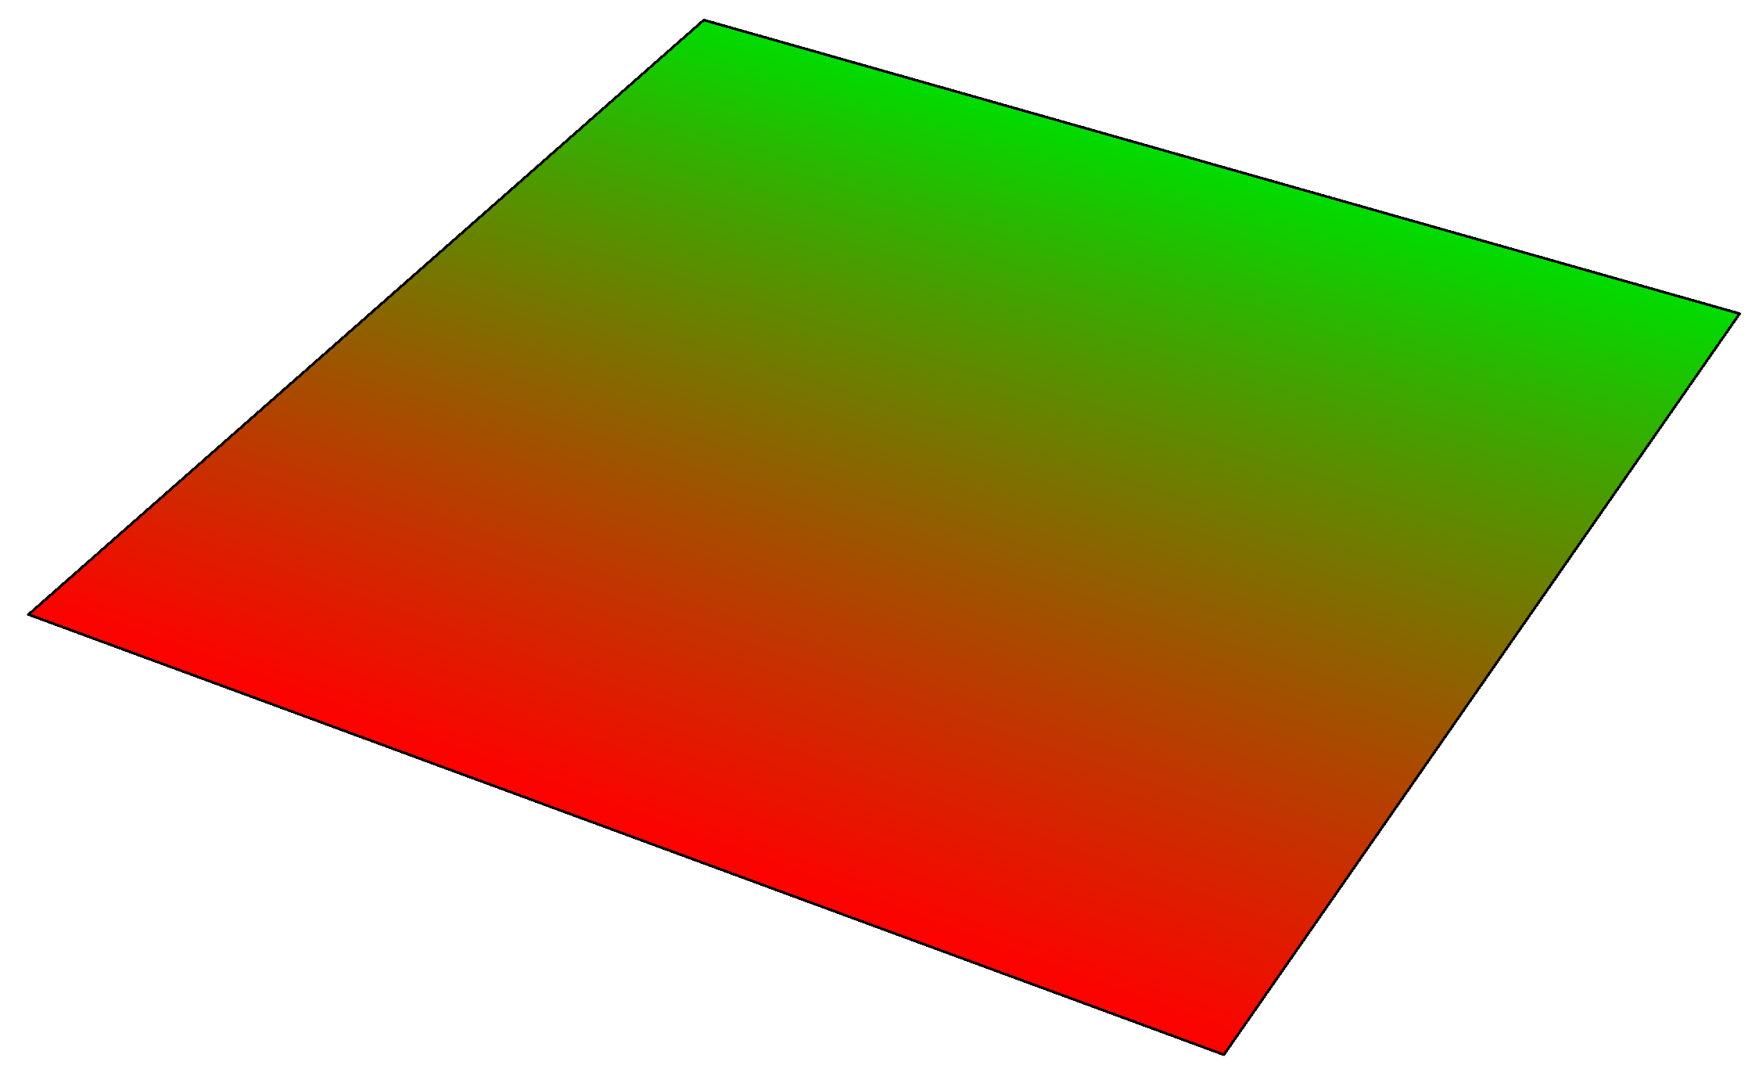
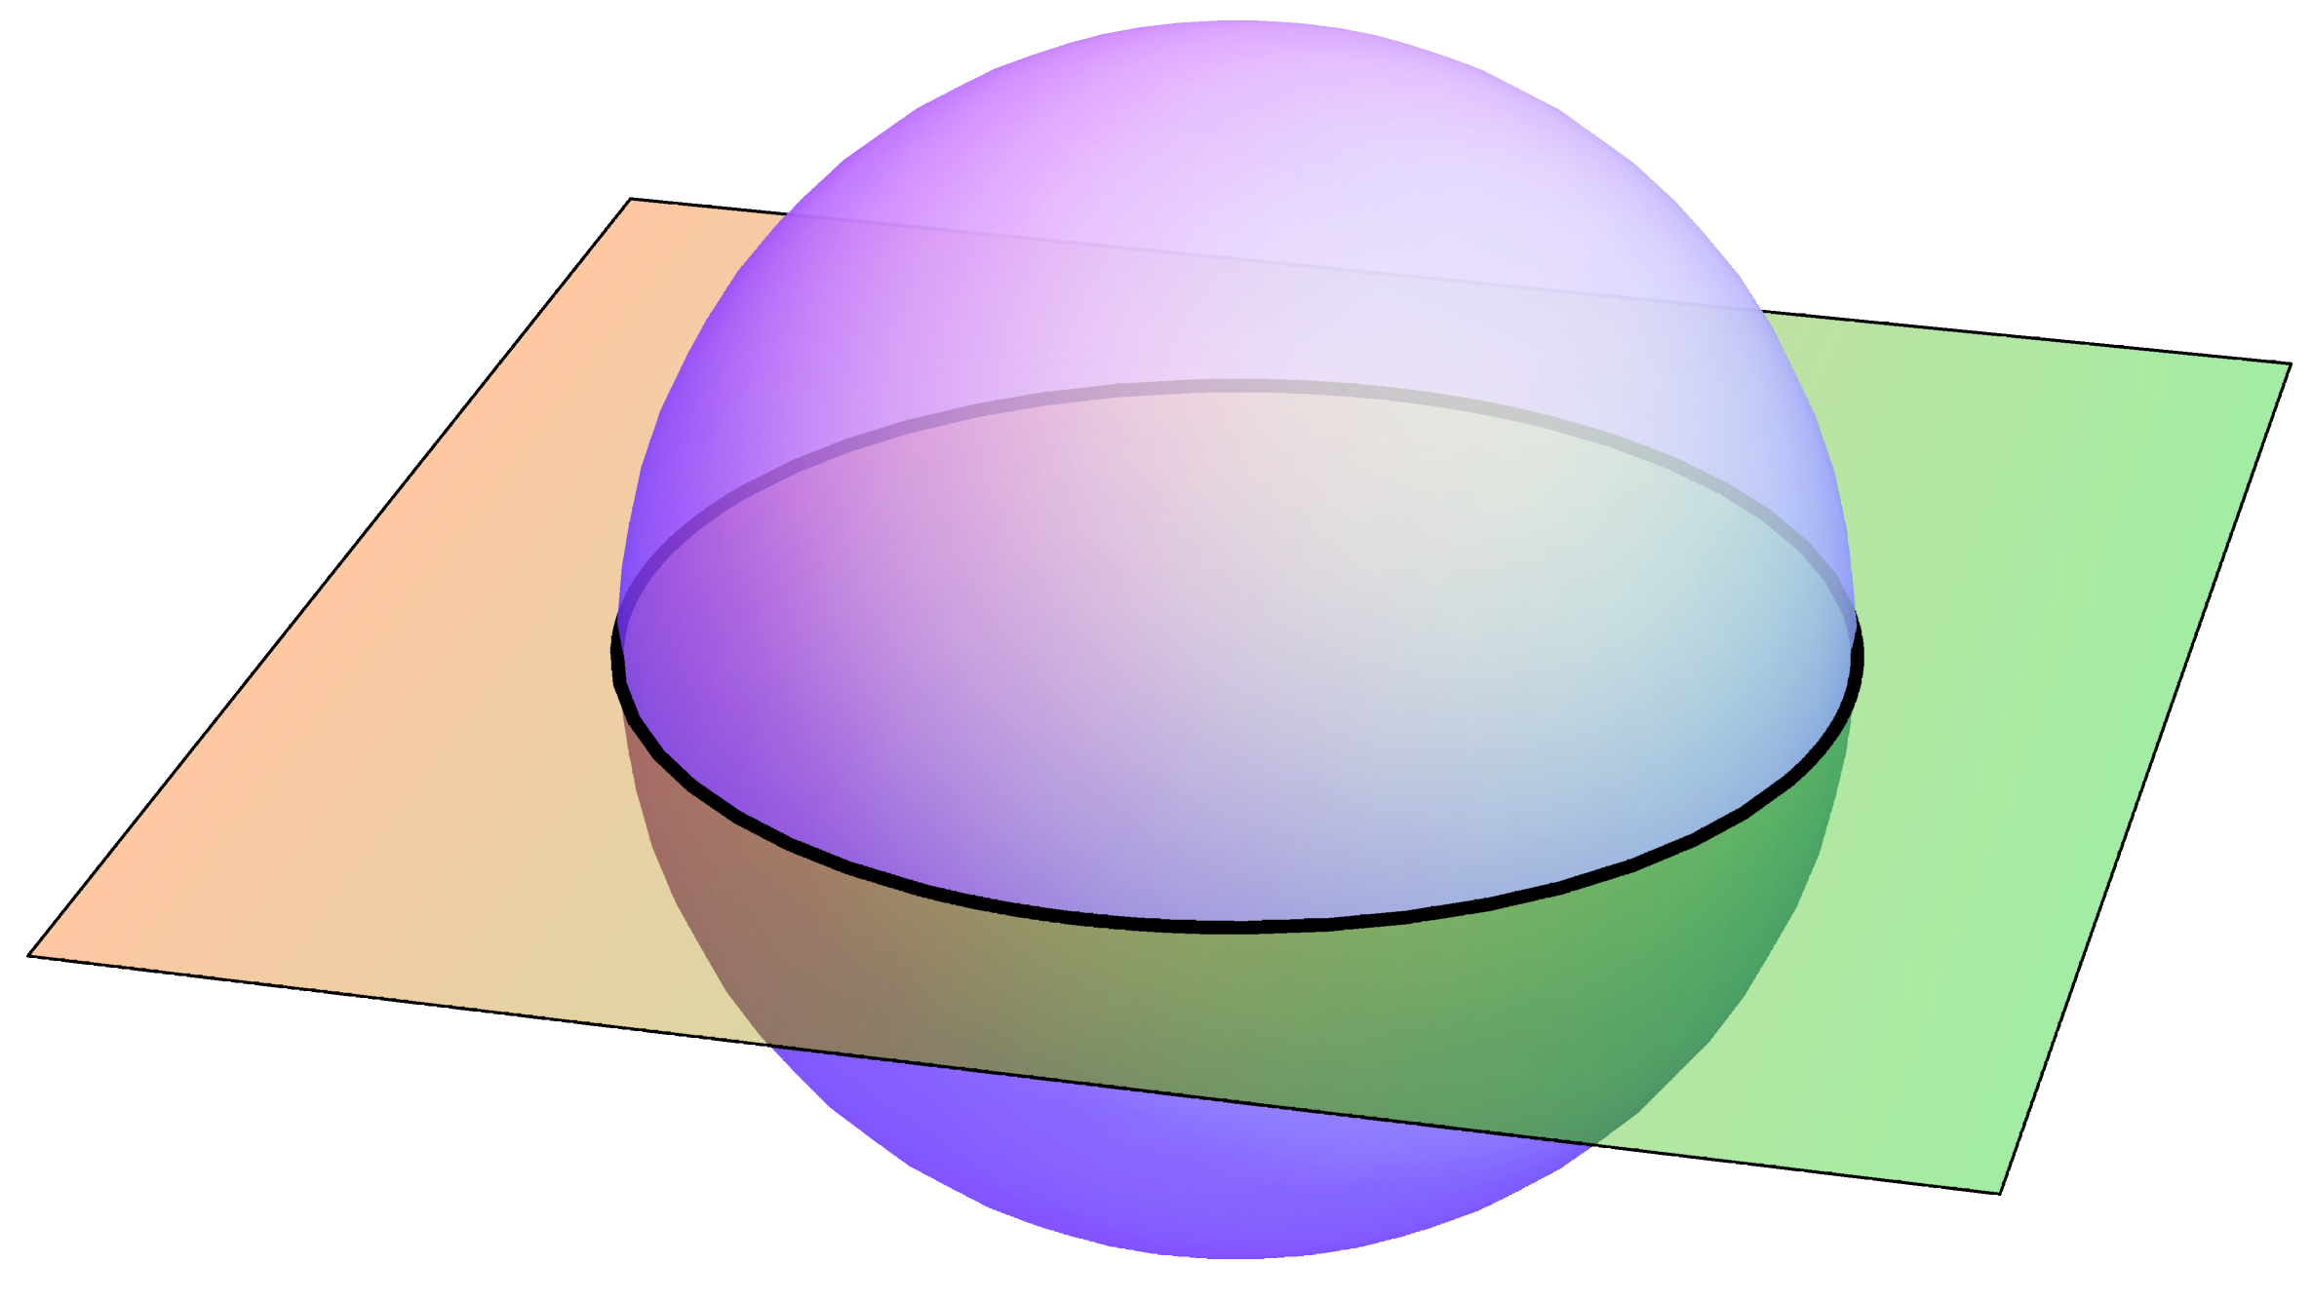
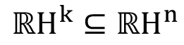
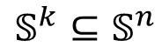
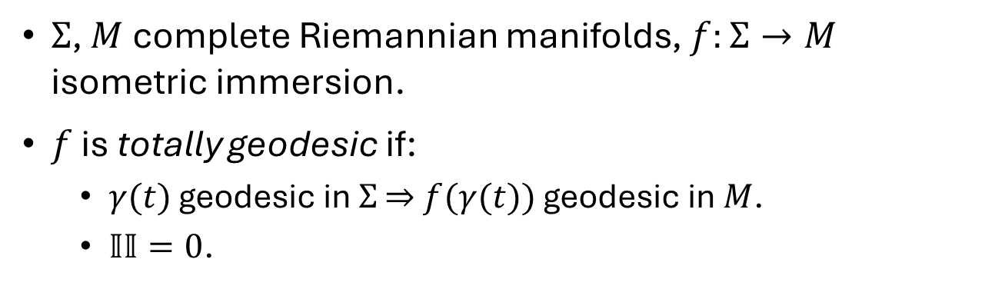
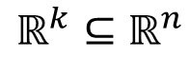
Totally geodesic submanifolds
$Σ$, $M$ complete Riemannian manifolds, $f:Σ→M$ isometric immersion.
$f$ is totally geodesic if:
$γ(t)$ geodesic in $Σ$ $⇒$ $f(γ(t))$ geodesic in $M$.
$𝕀𝕀=0$.
$$ℝ^{k}⊆ℝ^{n}$$
$$𝕊^{k}⊆𝕊^{n}$$
$${ℝH}^{k}⊆{ℝH}^{n}$$

Slide 3
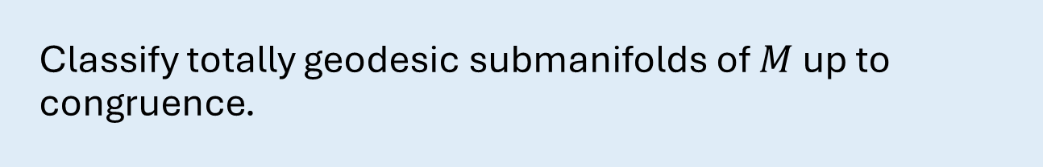
Totally geodesic submanifolds
$Σ$, $M$ complete Riemannian manifolds, $f:Σ→M$ isometric immersion.
$f$ is totally geodesic if:
$γ(t)$ geodesic in $Σ$ $⇒$ $f(γ(t))$ geodesic in $M$.
$𝕀𝕀=0$.
General problem
Classify totally geodesic submanifolds of $M$ up to congruence.

Slide 4
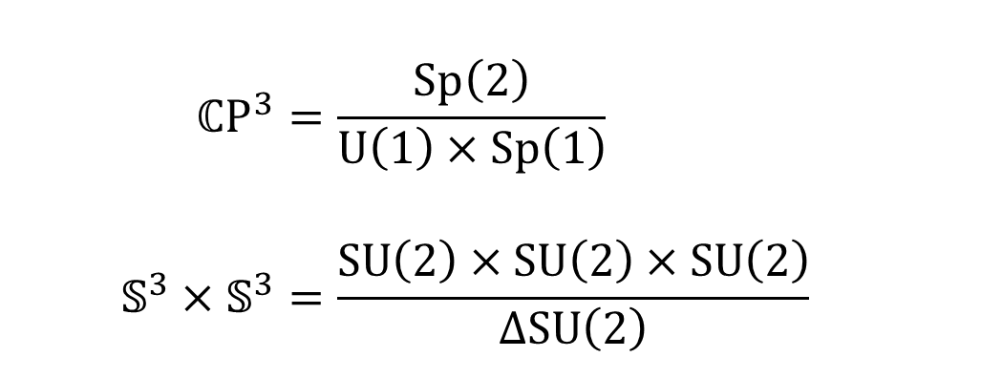
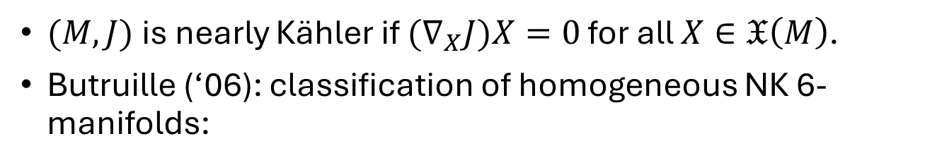
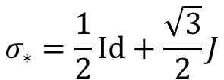
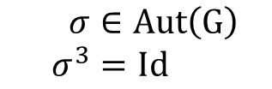
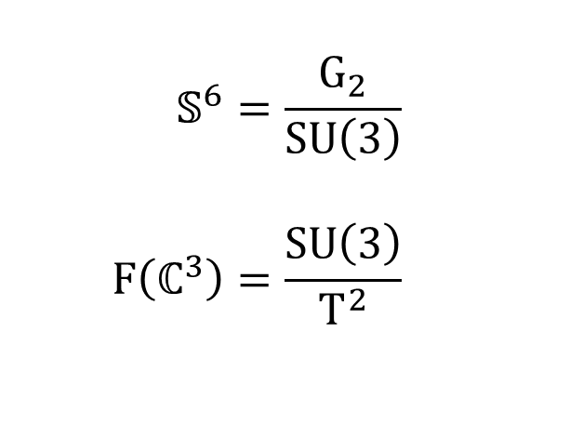
Nearly Kähler geometry
$(M,J)$ is nearly Kähler if ${(∇}_{X}J)X=0$ for all $X∈𝔛\left(M\right)$.
Butruille (‘06): classification of homogeneous NK 6-manifolds:
$$𝕊^{6}=\frac{G_{2}}{SU\left(3\right)} \\ F\left(ℂ^{3}\right)=\frac{SU\left(3\right)}{T^{2}}$$
$$ℂP^{3}=\frac{Sp\left(2\right)}{U\left(1\right)×Sp\left(1\right)} \\ 𝕊^{3}×𝕊^{3}=\frac{SU\left(2\right)×SU\left(2\right)×SU\left(2\right)}{ΔSU\left(2\right)}$$
$$σ∈Aut\left(G\right) \\ σ^{3}=Id$$
$$σ_{∗}=\frac{1}{2}Id+\frac{\sqrt{3}}{2}J$$

Slide 5
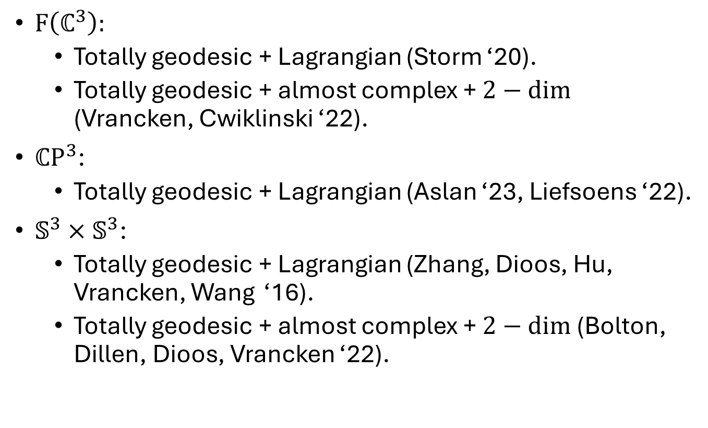
Previously known results
$F\left(ℂ^{3}\right):$
Totally geodesic + Lagrangian (Storm ‘20).
Totally geodesic + almost complex + $2−dim$ (Vrancken, Cwiklinski ‘22).
$ℂP^{3}$:
Totally geodesic + Lagrangian (Aslan ‘23, Liefsoens ‘22).
$𝕊^{3}×𝕊^{3}$:
Totally geodesic + Lagrangian (Zhang, Dioos, Hu, Vrancken, Wang ‘16).
Totally geodesic + almost complex + $2−dim$ (Bolton, Dillen, Dioos, Vrancken ‘22).

Slide 6
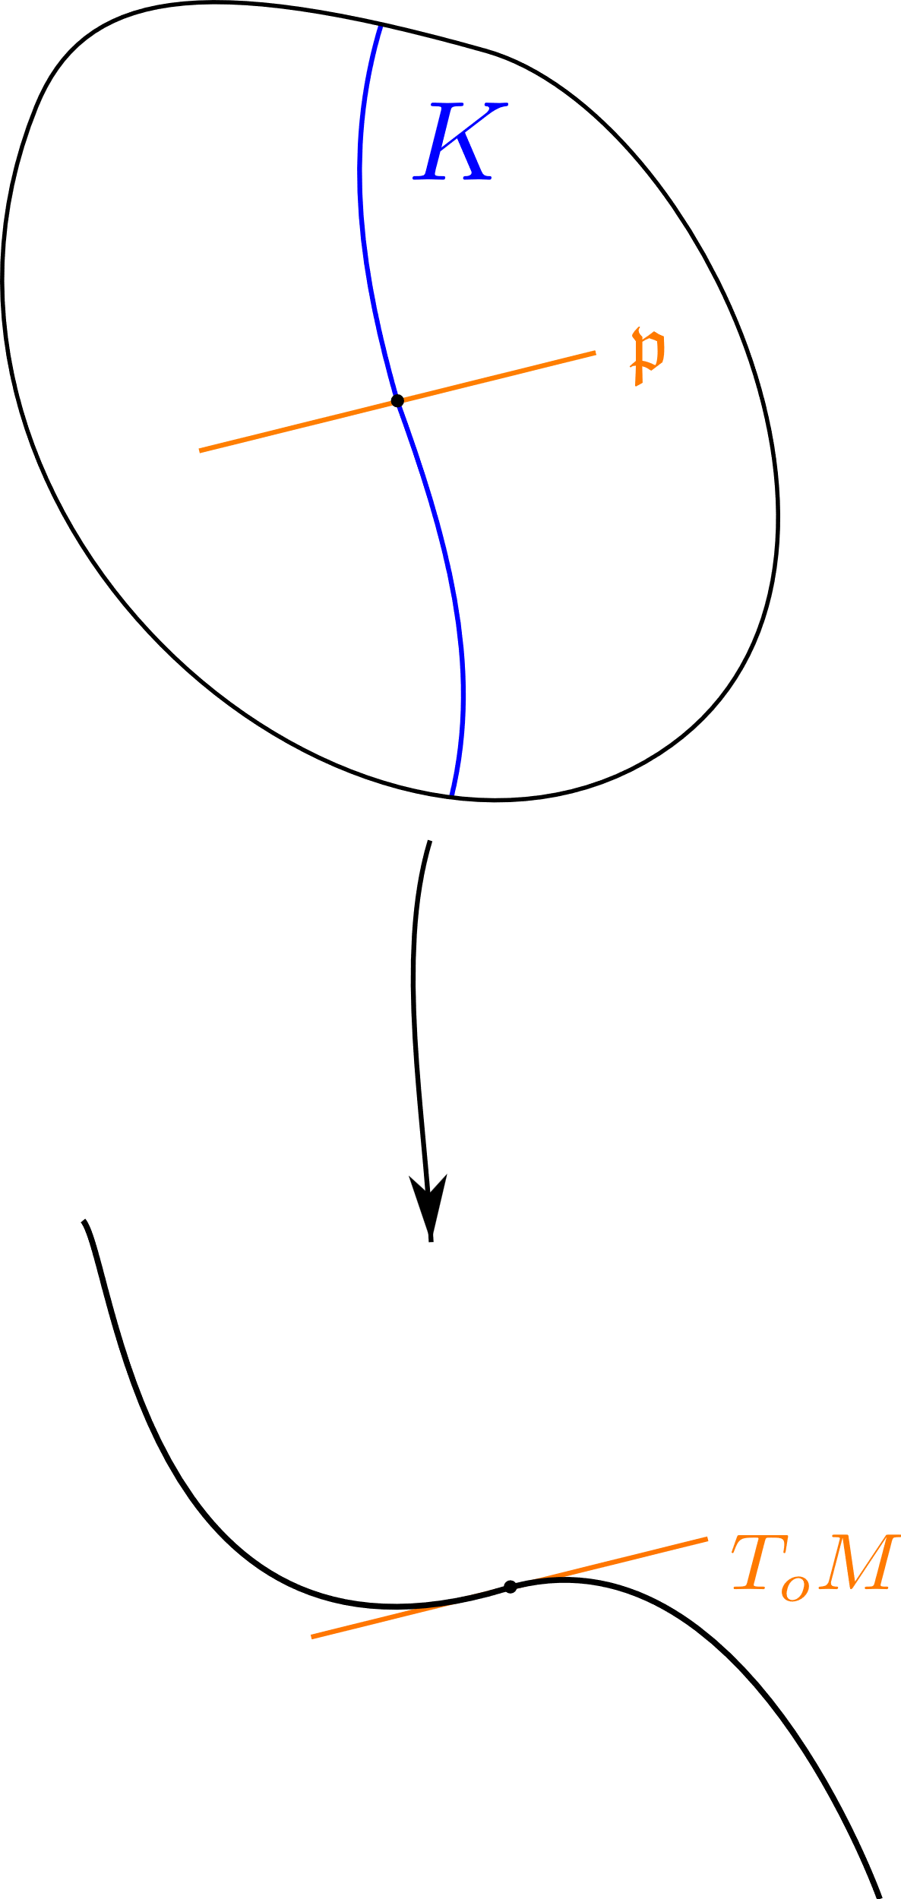
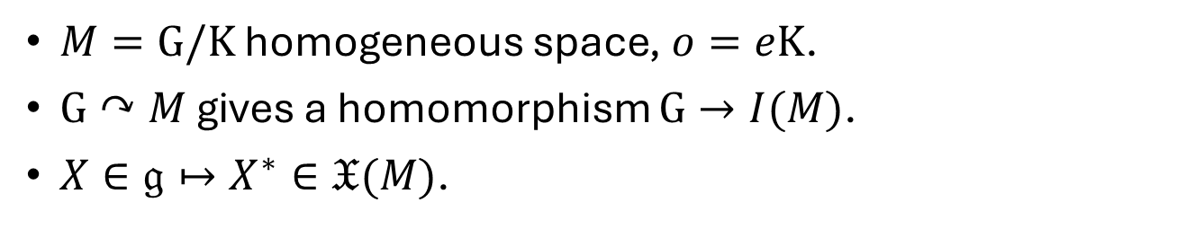
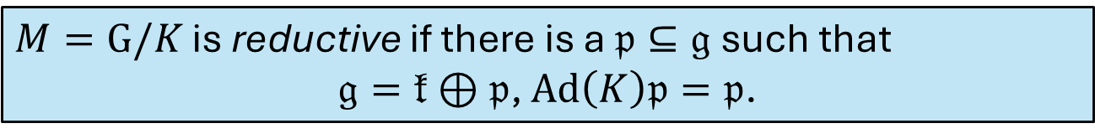
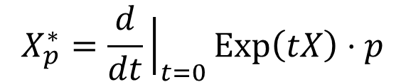
Reductive homogeneous spaces
$M=G/K$ homogeneous space, $o=eK$.
$G↷M$ gives a homomorphism $G→I(M)$.
$X∈𝔤↦X^{∗}∈𝔛(M)$.
$$X_{p}^{∗}=\frac{d}{dt}{\left.​\right|}_{t=0}Exp\left(tX\right)⋅p$$
$T_{o}M=𝔤/𝔨$ via $X+𝔨↦X_{o}^{∗}$.
$M=G/K$ is reductive if there is a $𝔭⊆𝔤$ such that
$𝔤=𝔨⊕𝔭$, $Ad\left(K\right)𝔭=𝔭$.

Slide 7
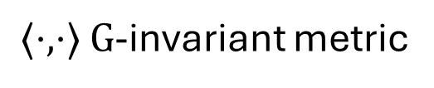
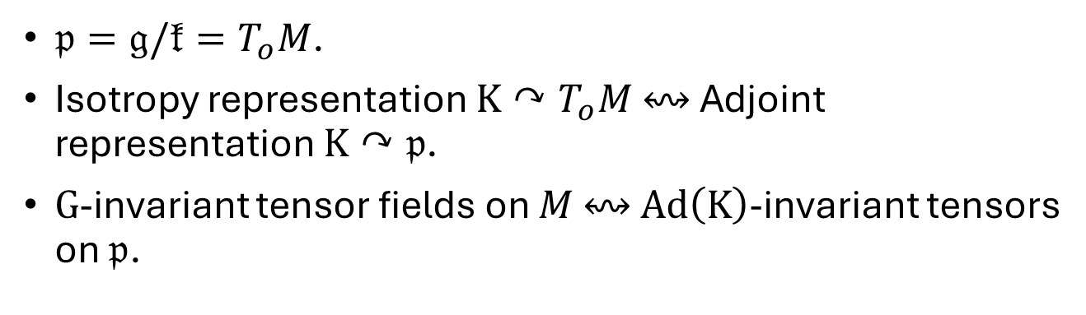
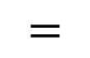
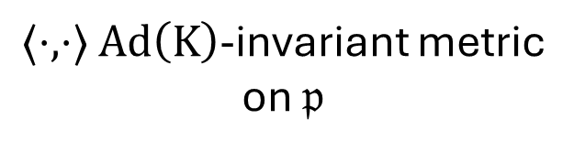
$𝔭=𝔤/𝔨=T_{o}M$.
Isotropy representation $K↷T_{o}M$ $↭$ Adjoint representation $K↷𝔭$.
$G$-invariant tensor fields on $M$ $↭$ $Ad\left(K\right)$-invariant tensors on $𝔭$.
$⟨⋅,⋅⟩$ $Ad\left(K\right)$-invariant metric
on $𝔭$
$⟨⋅,⋅⟩$ $G$-invariant metric
$$=$$

Slide 8
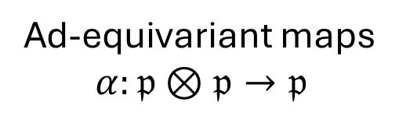
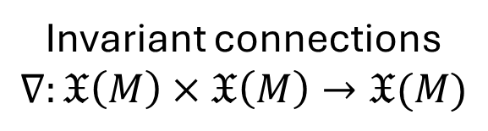
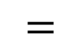
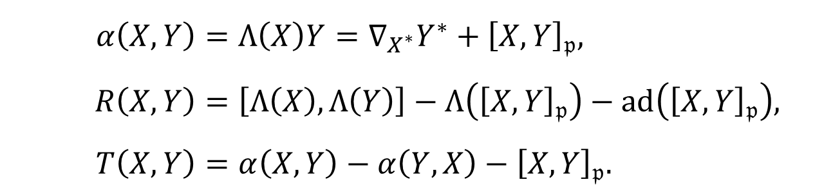
$𝔭=𝔤/𝔨=T_{o}M$.
Isotropy representation $K↷T_{o}M$ $↭$ Adjoint representation $K↷𝔭$.
$G$-invariant tensor fields on $M$ $↭$ $Ad\left(K\right)$-invariant tensors on $𝔭$.
Theorem (Nomizu ‘54)
Invariant connections
$$∇:𝔛\left(M\right)×𝔛\left(M\right)→𝔛(M)$$
Ad-equivariant maps
$$α:𝔭⊗𝔭→𝔭$$
$$=$$
$$α\left(X,Y\right)=Λ\left(X\right)Y=∇_{X^{∗}}Y^{∗}+{\left[X,Y\right]}_{𝔭}, \\ R\left(X,Y\right)=\left[Λ\left(X\right),Λ\left(Y\right)\right]−Λ\left({\left[X,Y\right]}_{𝔭}\right)−ad\left({\left[X,Y\right]}_{𝔭}\right), \\ T\left(X,Y\right)=α\left(X,Y\right)−α\left(Y,X\right)−{\left[X,Y\right]}_{𝔭}.$$

Slide 9
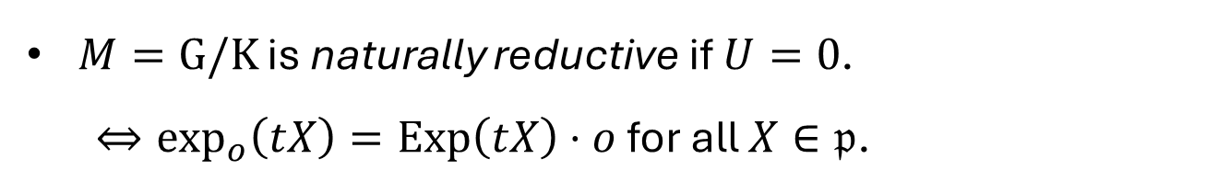
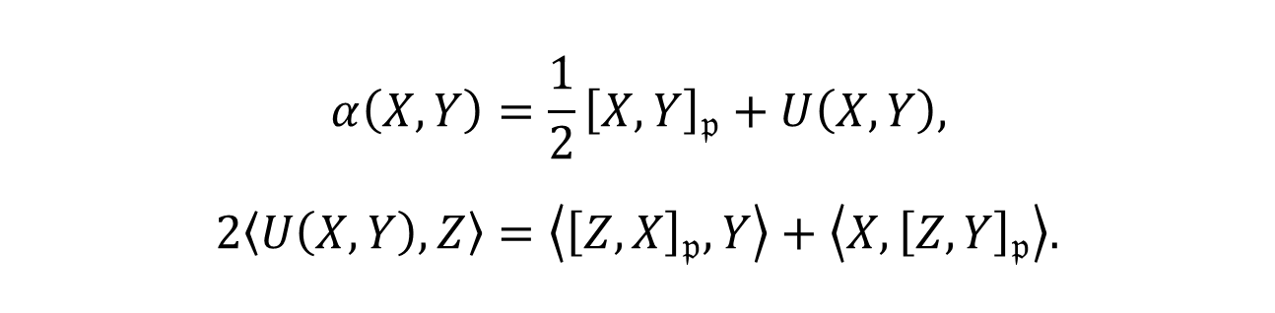
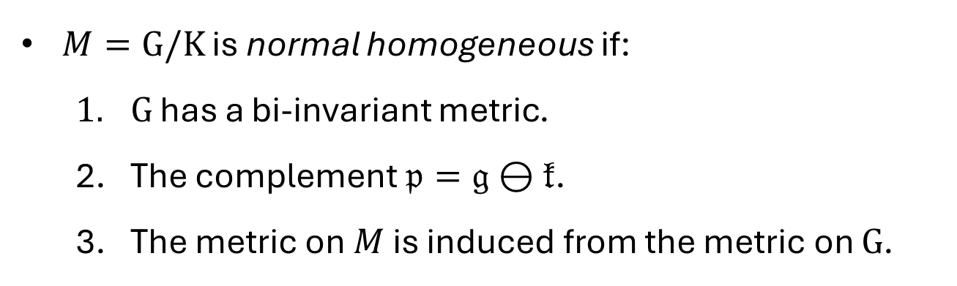
Natural reductivity
$$α\left(X,Y\right)=\frac{1}{2}{\left[X,Y\right]}_{𝔭}+U\left(X,Y\right), \\ 2\left\langle U\left(X,Y\right),Z\right\rangle =\left\langle {\left[Z,X\right]}_{𝔭},Y\right\rangle +\left\langle X,{\left[Z,Y\right]}_{𝔭}\right\rangle .$$
$M=G/K$ is naturally reductive if $U=0$.
$⇔\exp_{o}\left(tX\right)=Exp\left(tX\right)⋅o$ for all $X∈𝔭$.
$M=G/K$ is normal homogeneous if:
$G$ has a bi-invariant metric.
The complement $𝔭=𝔤⊖𝔨$.
The metric on $M$ is induced from the metric on $G$.

Slide 10
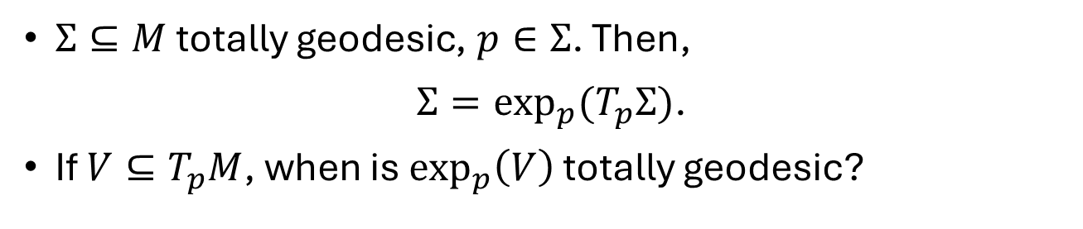
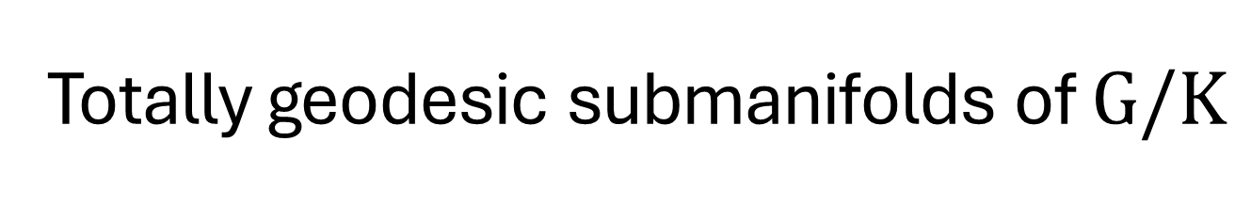
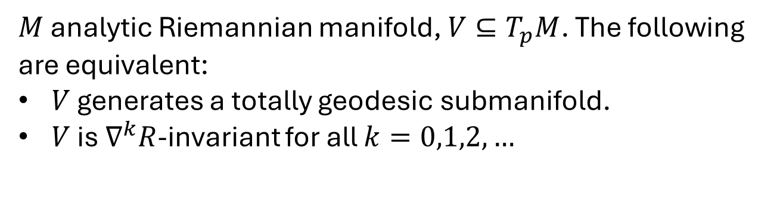
Totally geodesic submanifolds of $G/K$
$Σ⊆M$ totally geodesic, $p∈Σ$. Then,
$Σ=\exp_{p}{{(T}_{p}Σ)}$.
If $V⊆T_{p}M$, when is $\exp_{p}\left(V\right)$ totally geodesic?
Theorem (Cartan ‘51, Hermann ‘59)
$M$ analytic Riemannian manifold, $V⊆T_{p}M$. The following are equivalent:
$V$ generates a totally geodesic submanifold.
$V$ is $∇^{k}R$-invariant for all $k=0,1,2,…$

Slide 11
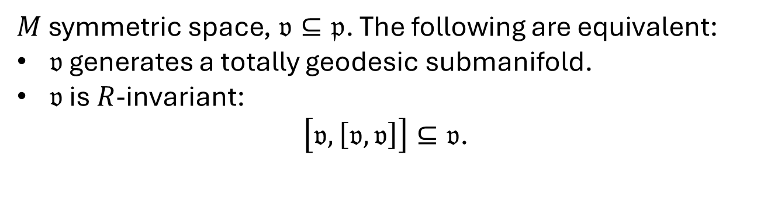
Totally geodesic submanifolds of $G/K$
$Σ⊆M$ totally geodesic, $p∈Σ$. Then,
$Σ=\exp_{p}{{(T}_{p}Σ)}$.
If $V⊆T_{p}M$, when is $\exp_{p}\left(V\right)$ totally geodesic?
Theorem (Cartan) for symmetric spaces
$M$ symmetric space, $𝔳⊆𝔭$. The following are equivalent:
$𝔳$ generates a totally geodesic submanifold.
$𝔳$ is $R$-invariant:
$\left[𝔳,\left[𝔳,𝔳\right]\right]⊆𝔳$.

Slide 12
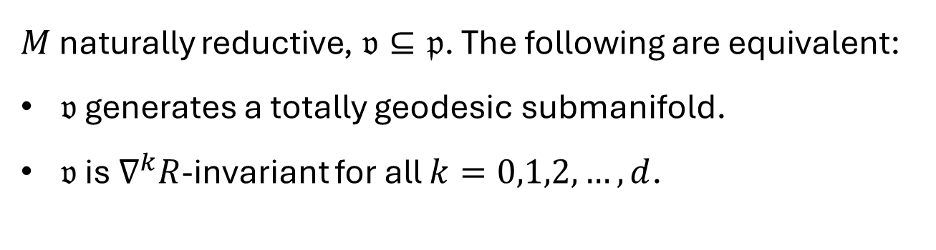
Totally geodesic submanifolds of $G/K$
$Σ⊆M$ totally geodesic, $p∈Σ$. Then,
$Σ=\exp_{p}{{(T}_{p}Σ)}$.
If $V⊆T_{p}M$, when is $\exp_{p}\left(V\right)$ totally geodesic?
Theorem (Cartan) for naturally reductive spaces
$M$ naturally reductive, $𝔳⊆𝔭$. The following are equivalent:
$𝔳$ generates a totally geodesic submanifold.
$𝔳$ is $∇^{k}R$-invariant for all $k=0,1,2,…,d$.

Slide 13
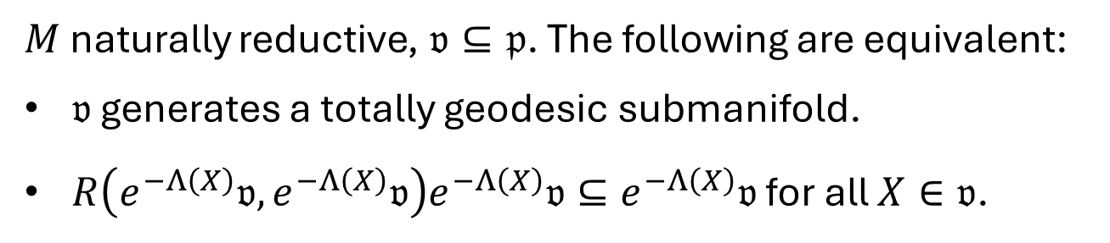
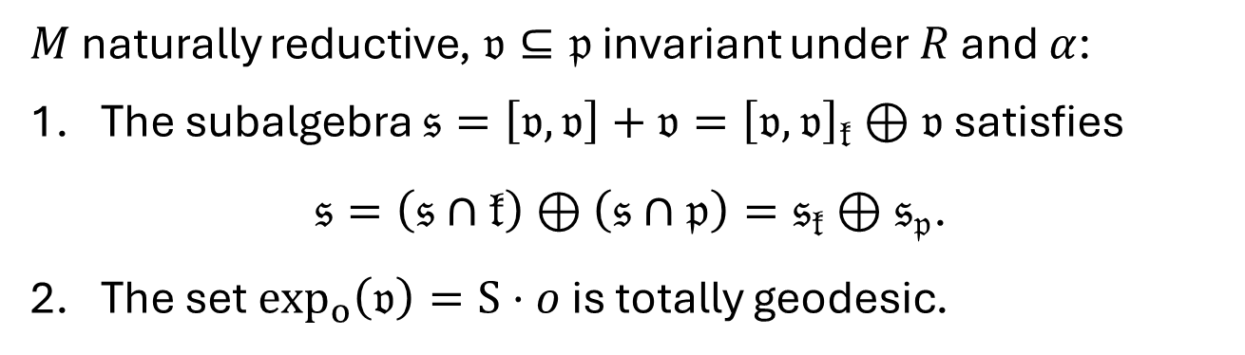
Tojo’s criterion (‘96)
$M$ naturally reductive, $𝔳⊆𝔭$. The following are equivalent:
$𝔳$ generates a totally geodesic submanifold.
$R\left(e^{−Λ\left(X\right)}𝔳,e^{−Λ\left(X\right)}𝔳\right)e^{−Λ\left(X\right)}𝔳⊆e^{−Λ\left(X\right)}𝔳$ for all $X∈𝔳$.
Sufficient criterion (LN—Rodríguez-Vázquez)
$M$ naturally reductive, $𝔳⊆𝔭$ invariant under $R$ and $α$:
The subalgebra $𝔰=\left[𝔳,𝔳\right]+𝔳={\left[𝔳,𝔳\right]}_{𝔨}⊕𝔳$ satisfies
$𝔰=\left(𝔰∩𝔨\right)⊕\left(𝔰∩𝔭\right)=𝔰_{𝔨}⊕𝔰_{𝔭}$.
The set $\exp_{o}\left(𝔳\right)=S⋅o$ is totally geodesic.

Slide 14
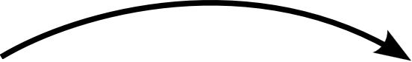
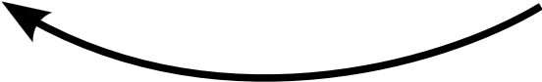
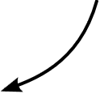
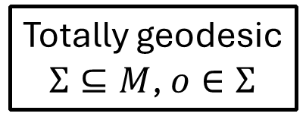
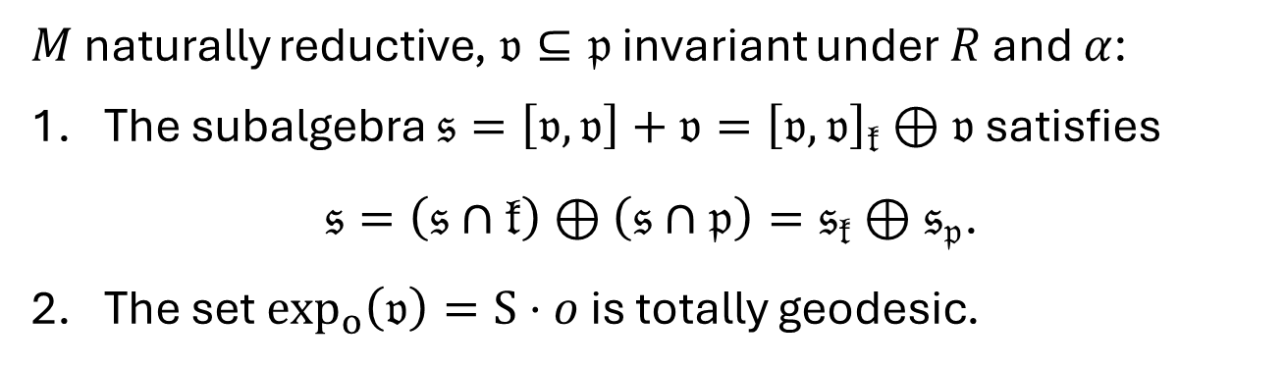
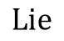
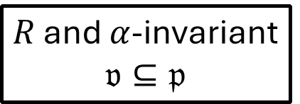
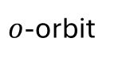
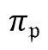
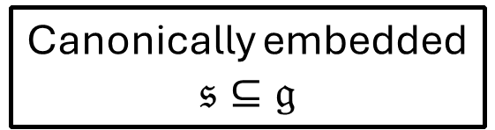
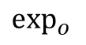
Sufficient criterion (LN—Rodríguez-Vázquez)
$M$ naturally reductive, $𝔳⊆𝔭$ invariant under $R$ and $α$:
The subalgebra $𝔰=\left[𝔳,𝔳\right]+𝔳={\left[𝔳,𝔳\right]}_{𝔨}⊕𝔳$ satisfies
$𝔰=\left(𝔰∩𝔨\right)⊕\left(𝔰∩𝔭\right)=𝔰_{𝔨}⊕𝔰_{𝔭}$.
The set $\exp_{o}\left(𝔳\right)=S⋅o$ is totally geodesic.
$$π_{𝔭}$$
Canonically embedded
$$𝔰⊆𝔤$$
$R$ and $α$-invariant
$$𝔳⊆𝔭$$
$$Lie$$
$o$-orbit
Totally geodesic
$Σ⊆M$, $o∈Σ$
$$\exp_{o}{ }$$

Slide 15
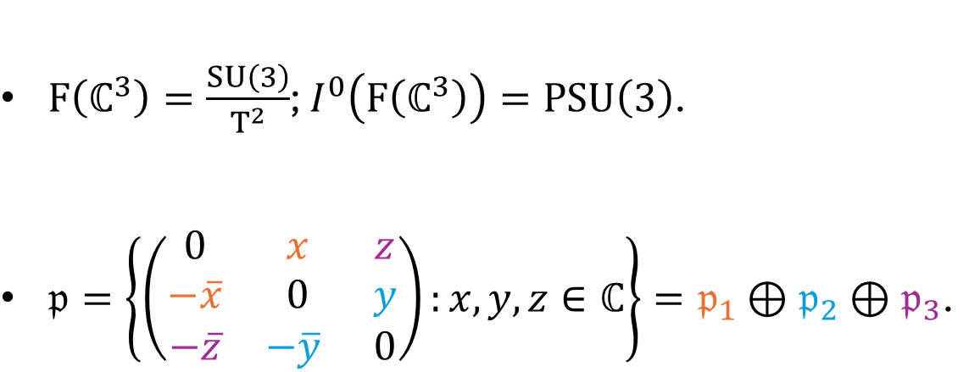




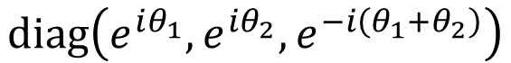
The flag manifold $F\left(ℂ^{3}\right)$
$F\left(ℂ^{3}\right)=\frac{SU\left(3\right)}{T^{2}}$; $I^{0}\left(F\left(ℂ^{3}\right)\right)=PSU\left(3\right)$.
$𝔭=\left\{\left(\begin{matrix}0 & x & z \\ −\overline{x} & 0 & y \\ −\overline{z} & −\overline{y} & 0\end{matrix}\right):x,y,z∈ℂ\right\}=𝔭_{1}⊕𝔭_{2}⊕𝔭_{3}$.
$$e^{i\left(θ_{1}−θ_{2}\right)}$$
$$diag\left(e^{iθ_{1}},e^{iθ_{2}},e^{−i\left(θ_{1}+θ_{2}\right)}\right)$$
$$e^{i\left(θ_{1}+2θ_{2}\right)}$$
$$e^{i\left({2θ}_{1}+θ_{2}\right)}$$

Slide 16
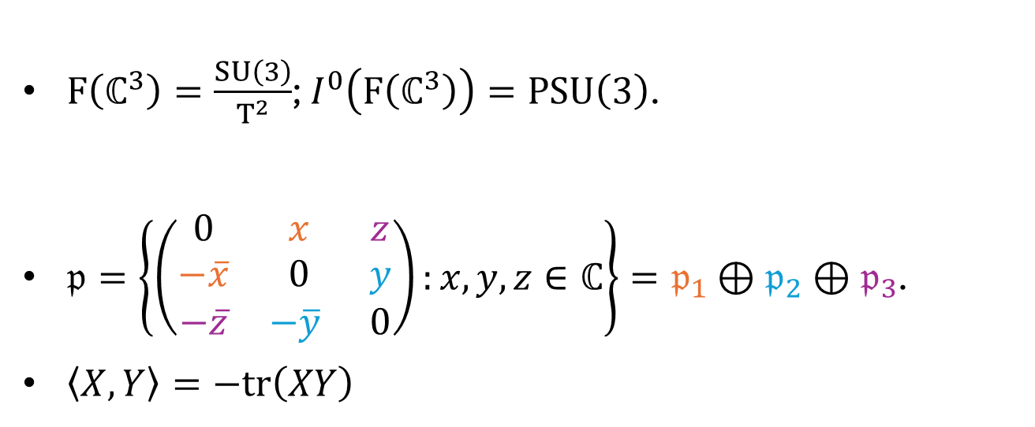
The flag manifold $F\left(ℂ^{3}\right)$
$F\left(ℂ^{3}\right)=\frac{SU\left(3\right)}{T^{2}}$; $I^{0}\left(F\left(ℂ^{3}\right)\right)=PSU\left(3\right)$.
$𝔭=\left\{\left(\begin{matrix}0 & x & z \\ −\overline{x} & 0 & y \\ −\overline{z} & −\overline{y} & 0\end{matrix}\right):x,y,z∈ℂ\right\}=𝔭_{1}⊕𝔭_{2}⊕𝔭_{3}$.
$\left\langle X,Y\right\rangle =−tr\left(XY\right)$

Slide 17


The flag manifold $F\left(ℂ^{3}\right)$
$F\left(ℂ^{3}\right)=\frac{SU\left(3\right)}{T^{2}}$; $I^{0}\left(F\left(ℂ^{3}\right)\right)=PSU\left(3\right)$.
$𝔭=\left\{\left(\begin{matrix}0 & x & z \\ −\overline{x} & 0 & y \\ −\overline{z} & −\overline{y} & 0\end{matrix}\right):x,y,z∈ℂ\right\}=𝔭_{1}⊕𝔭_{2}⊕𝔭_{3}$.
$T^{2}⊆U\left(2\right)⊆SU\left(3\right)$ gives the fibration $ℂP^{1}→F\left(ℂ^{3}\right)→ℂP^{2}$.
$𝒱_{o}=𝔭_{1}$, $ℋ_{o}=𝔭_{2}⊕𝔭_{3}$.
General fact:
$K⊆H⊆G$ gives a fibration
$H/K→G/K→G/H$.

Slide 18



The complex projective space $ℂP^{3}$
$ℂP^{3}=\frac{Sp\left(2\right)}{U\left(1\right)×Sp\left(1\right)}$; $I^{0}\left(ℂP^{3}\right)=\frac{Sp\left(2\right)}{ℤ^{2}}$.
$𝔭=\left\{\left(\begin{matrix}zj & −\overline{q} \\ q & 0\end{matrix}\right):z∈ℂ,q∈ℍ\right\}=𝔭_{1}⊕𝔭_{2}$.
$$\left(λ,μ\right)⋅z=λ^{2}z \\ \left(λ,μ\right)⋅q=μq\overline{λ}$$

Slide 19

The complex projective space $ℂP^{3}$
$ℂP^{3}=\frac{Sp\left(2\right)}{U\left(1\right)×Sp\left(1\right)}$; $I^{0}\left(ℂP^{3}\right)=\frac{Sp\left(2\right)}{ℤ^{2}}$.
$𝔭=\left\{\left(\begin{matrix}zj & −\overline{q} \\ q & 0\end{matrix}\right):z∈ℂ,q∈ℍ\right\}=𝔭_{1}⊕𝔭_{2}$.
$\left\langle X,Y\right\rangle =−2Re tr_{ℍ}\left(XY\right)$.

Slide 20

The complex projective space $ℂP^{3}$
$ℂP^{3}=\frac{Sp\left(2\right)}{U\left(1\right)×Sp\left(1\right)}$; $I^{0}\left(ℂP^{3}\right)=\frac{Sp\left(2\right)}{ℤ^{2}}$.
$𝔭=\left\{\left(\begin{matrix}zj & −\overline{q} \\ q & 0\end{matrix}\right):z∈ℂ,q∈ℍ\right\}=𝔭_{1}⊕𝔭_{2}.$
$U\left(1\right)×Sp\left(1\right)⊆Sp\left(1\right)×Sp\left(1\right)⊆Sp\left(2\right)$ gives the fibration $ℂP^{1}→ℂP^{3}→ℍP^{1}=𝕊^{4}$.
$𝒱_{o}=𝔭_{1}$, $ℋ_{o}=𝔭_{2}$.

Slide 21


The almost product $𝕊^{3}×𝕊^{3}$
$𝕊^{3}×𝕊^{3}=\frac{SU{\left(2\right)}^{3}}{ΔSU\left(2\right)}$; $I^{0}\left(𝕊^{3}×𝕊^{3}\right)=\frac{SU{\left(2\right)}^{3}}{Δℤ_{2}}$.
$𝔭=\left\{\left(X,Y,Z\right):X+Y+Z=0\right\}=𝔭_{1}⊕𝔭_{2}$.
$𝔭_{1}=\left\{\left(X,−2X,X\right):X∈𝔰𝔲\left(2\right)\right\}≅Ad$.
$𝔭_{2}=\left\{\left(X,0,−X\right):X∈𝔰𝔲\left(2\right)\right\}≅Ad$.
$\left\langle \left(X,Y,Z\right),\left(X^{′},Y^{′},Z^{′}\right)\right\rangle =−tr\left(XX^{′}\right)−tr\left(YY^{′}\right)−tr\left({ZZ}^{′}\right)$.

Slide 22

The almost product $𝕊^{3}×𝕊^{3}$
$𝕊^{3}×𝕊^{3}=\frac{SU{\left(2\right)}^{3}}{ΔSU\left(2\right)}$; $I^{0}\left(𝕊^{3}×𝕊^{3}\right)=\frac{SU{\left(2\right)}^{3}}{Δℤ_{2}}$.
$𝔭=\left\{\left(X,Y,Z\right):X+Y+Z=0\right\}=𝔭_{1}⊕𝔭_{2}$.
$ΔSU\left(2\right)⊆Δ_{13}SU\left(2\right)×SU{\left(2\right)}_{2}⊆SU{\left(2\right)}^{3}$ gives the fibration $𝕊^{3}→𝕊^{3}×𝕊^{3}→𝕊^{3}$.
$𝒱_{o}=𝔭_{1}$, $ℋ_{o}=𝔭_{2}$.

Slide 23


Low codimension
Theorem (Nikolayevsky ‘15)
$M$ simply connected, compact and homogeneous.
If there exists $Σ⊆M$ totally geodesic hypersurface, then $M=𝕊^{n}$.
Corollary
$M∈\left\{F\left(ℂ^{3}\right),ℂP^{3},𝕊^{3}×𝕊^{3}\right\}$ has no totally geodesic hypersurfaces.

Slide 24

Low codimension
Theorem (Nikolayevsky ‘15)
$M$ simply connected, compact and homogeneous.
If there exists $Σ⊆M$ totally geodesic hypersurface, then $M=𝕊^{n}$.
Theorem
$M∈\left\{F\left(ℂ^{3}\right),ℂP^{3},𝕊^{3}×𝕊^{3}\right\}$ has no totally geodesic submanifolds of codimension $≤2$.

Slide 25

Dimension three
Ambient | Submanifold | Orbit of
$$F\left(ℂ^{3}\right)$$ | $$F\left(ℝ^{3}\right)=𝕊^{3}/Q_{8}$$ | $$SO\left(3\right)$$
 | $$𝕊_{ℂ}^{3}$$ | $$SU\left(2\right)$$
$$ℂP^{3}$$ | $$ℝP_{ℂ}^{3}$$ | $$SU{\left(2\right)}^{j}$$
$$𝕊^{3}×𝕊^{3}$$ | $$𝕊^{3}\left(2/\sqrt{3}\right)$$ | $$SU{\left(2\right)}_{2}$$
 | $$𝕊_{ℂ}^{3}$$ | $$Δ_{13}SU\left(2\right)×SU{\left(2\right)}_{2}$$
All of these are Lagrangian.

Slide 26


Dimension two in ${F(ℂ}^{3})$
Submanifold | Orbit of | Relationship with $J$
$$T_{A}=ℝ^{2}/A$$ | $$T^{2}$$ | Almost complex
$${ℂP^{1}=𝕊}^{2}\left(1/\sqrt{2}\right)$$ | $$U\left(2\right)$$ | Almost complex
$$𝕊^{2}\left(\sqrt{2}\right)$$ | $$SO\left(3\right)$$ | Almost complex
$$ℝP^{2}→F\left(ℝ^{3}\right)$$ | Inhomogeneous | Totally real

Slide 27



Dimension two in ${F(ℂ}^{3})$
Submanifold | Orbit of | Relationship with $J$
$$T_{A}=ℝ^{2}/A$$ | $$T^{2}$$ | Almost complex
$$A=ℤ−span\left\{\left(0,\frac{2\sqrt{2}π}{\sqrt{3}}\right),\left(\sqrt{2}π,\frac{\sqrt{2}}{\sqrt{3}}π\right)\right\}$$

Slide 28


Dimension two in ${F(ℂ}^{3})$
Submanifold | Orbit of | Relationship with $J$
$$T_{A}=ℝ^{2}/A$$ | $$T^{2}$$ | Almost complex

Slide 29


Dimension two in $ℂP^{3}$
Submanifold | Orbit of | Relationship with $J$
$$𝕊^{2}\left(1/\sqrt{2}\right)$$ | $$Sp{\left(1\right)}_{f}$$ | Almost complex
$$𝕊^{2}\left(1\right)$$ | $$SU\left(2\right)$$ | Almost complex
$$𝕊^{2}\left(\sqrt{5}\right)$$ | $$SU{\left(2\right)}_{Λ_{3}}$$ | Almost complex
$Λ_{3}=Sym^{3}\left(ℂ^{2}\right)$: three-dimensional irrep. of $SU\left(2\right)$.
$$\left(\begin{matrix}a & −\overline{b} \\ b & \overline{a}\end{matrix}\right)⟼\left(\begin{matrix}a\left({\left|a\right|}^{2}−2{\left|b\right|}^{2}\right) & −{\sqrt{3}a}^{2}\overline{b} \\ {\sqrt{3}a}^{2}\overline{b} & a^{3}\end{matrix}\right)+j\left(\begin{matrix}b\left(2{\left|a\right|}^{2}−{\left|b\right|}^{2}\right) & −\sqrt{3}ab^{2} \\ \sqrt{3}\overline{a}b^{2} & −b^{3}\end{matrix}\right)$$

Slide 30


Dimension two in $𝕊^{3}×𝕊^{3}$
Submanifold | Orbit of | Relationship with $J$
$$T_{B}=ℝ^{2}/B$$ | $$T⊆U{\left(1\right)}^{3}$$ | Almost complex
$$𝕊^{2}\left(\sqrt{3}/\sqrt{2}\right)$$ | $$ΔSU\left(2\right)$$ | Almost complex
$$𝕊^{2}⊆𝕊^{3}\left(2/\sqrt{3}\right)$$ | $$H⊆Δ_{13}SU\left(2\right)×SU{\left(2\right)}_{2}$$ | Totally real

Slide 31



Dimension two in $𝕊^{3}×𝕊^{3}$
Submanifold | Orbit of | Relationship with $J$
$$T_{B}=ℝ^{2}/B$$ | $$T⊆U{\left(1\right)}^{3}$$ | Almost complex
$$B=ℤ−span\left\{\left(\frac{4π}{\sqrt{3}},0\right),\left(\frac{2π}{\sqrt{3}},2π\right)\right\}$$

Slide 32


Dimension two in $𝕊^{3}×𝕊^{3}$
Submanifold | Orbit of | Relationship with $J$
$$T_{B}=ℝ^{2}/B$$ | $$T⊆U{\left(1\right)}^{3}$$ | Almost complex

Slide 33

Ambient | Submanifold | Orbit of | Relationship with $J$
$$F\left(ℂ^{3}\right)$$ | $$F\left(ℝ^{3}\right)$$ | $$SO\left(3\right)$$ | Lagrangian
 | $$𝕊_{ℂ}^{3}$$ | $$SU\left(2\right)$$ | Lagrangian
 | $$T_{A}$$ | $$T^{2}$$ | Almost complex
 | $${ℂP^{1}=𝕊}^{2}\left(1/\sqrt{2}\right)$$ | $$U\left(2\right)$$ | Almost complex
 | $$𝕊^{2}\left(\sqrt{2}\right)$$ | $$SO\left(3\right)$$ | Almost complex
 | $$ℝP^{2}→F\left(ℝ^{3}\right)$$ | Inhomogeneous | Totally real
$$ℂP^{3}$$ | $$ℝP_{ℂ}^{3}$$ | $$SU{\left(2\right)}^{j}$$ | Lagrangian
 | $$𝕊^{2}\left(1/\sqrt{2}\right)$$ | $$Sp{\left(1\right)}_{f}$$ | Almost complex
 | $$𝕊^{2}\left(1\right)$$ | $$SU\left(2\right)$$ | Almost complex
 | $$𝕊^{2}\left(\sqrt{5}\right)$$ | $$SU{\left(2\right)}_{Λ_{3}}$$ | Almost complex
$$𝕊^{3}×𝕊^{3}$$ | $$𝕊^{3}\left(2/\sqrt{3}\right)$$ | $$SU{\left(2\right)}_{2}$$ | Lagrangian
 | $$𝕊_{ℂ}^{3}$$ | $$Δ_{13}SU\left(2\right)×SU{\left(2\right)}_{2}$$ | Lagrangian
 | $$T_{B}$$ | $$T⊆U{\left(1\right)}^{3}$$ | Almost complex
 | $$𝕊^{2}\left(\sqrt{3}/\sqrt{2}\right)$$ | $$ΔSU\left(2\right)$$ | Almost complex
 | $$𝕊^{2}⊆𝕊^{3}\left(2/\sqrt{3}\right)$$ | $$H⊆Δ_{13}SU\left(2\right)×SU{\left(2\right)}_{2}$$ | Totally real

Slide 34


Slide 35
Ambient | Submanifold | Orbit of | Relationship with $J$
$$F\left(ℂ^{3}\right)$$ | $$F\left(ℝ^{3}\right)$$ | $$SO\left(3\right)$$ | Lagrangian
 | $$𝕊_{ℂ}^{3}$$ | $$SU\left(2\right)$$ | Lagrangian
 | $$T_{A}$$ | $$T^{2}$$ | Almost complex
 | $${ℂP^{1}=𝕊}^{2}\left(1/\sqrt{2}\right)$$ | $$U\left(2\right)$$ | Almost complex
 | $$𝕊^{2}\left(\sqrt{2}\right)$$ | $$SO\left(3\right)$$ | Almost complex
 | $$ℝP^{2}→F\left(ℝ^{3}\right)$$ | Inhomogeneous | Totally real
$$ℂP^{3}$$ | $$ℝP_{ℂ}^{3}$$ | $$SU{\left(2\right)}^{j}$$ | Lagrangian
 | $$𝕊^{2}\left(1/\sqrt{2}\right)$$ | $$Sp{\left(1\right)}_{f}$$ | Almost complex
 | $$𝕊^{2}\left(1\right)$$ | $$SU\left(2\right)$$ | Almost complex
 | $$𝕊^{2}\left(\sqrt{5}\right)$$ | $$SU{\left(2\right)}_{Λ_{3}}$$ | Almost complex
$$𝕊^{3}×𝕊^{3}$$ | $$𝕊^{3}\left(2/\sqrt{3}\right)$$ | $$SU{\left(2\right)}_{2}$$ | Lagrangian
 | $$𝕊_{ℂ}^{3}$$ | $$Δ_{13}SU\left(2\right)×SU{\left(2\right)}_{2}$$ | Lagrangian
 | $$T_{B}$$ | $$T⊆U{\left(1\right)}^{3}$$ | Almost complex
 | $$𝕊^{2}\left(\sqrt{3}/\sqrt{2}\right)$$ | $$ΔSU\left(2\right)$$ | Almost complex
 | $$𝕊^{2}⊆𝕊^{3}\left(2/\sqrt{3}\right)$$ | $$H⊆Δ_{13}SU\left(2\right)×SU{\left(2\right)}_{2}$$ | Totally real

